Slide 1
Phone Reader 2.0
By: Hadley Scholtz
Supervisor: Mehrdad Ghaziasgar
Co - supervisor: James Connan
Mentor: Ibraheem Frieslaar

Slide 2
Overview
Quick Recap
High Level Design
Implementation
Testing
References
Demo
Questions and Answers

Slide 3
Quick Recap
Problem
Text in foreign languages are not understood
Users with impaired vision
Users that are illiterate.
Previous Solution
Phone Reader
Excellent novel idea.
Proposed Solution
Application with which users can take pictures, make selections and have selections read on their command.

Slide 4
High Level Design
Take Picture or opening an existing one
Make Selections
Send to server
Optical Character Recognition and Translation
Image pre-processing
Source image and coordinates
Send extracted text to device
Text-to-speech
Audio playback or text display

Slide 5
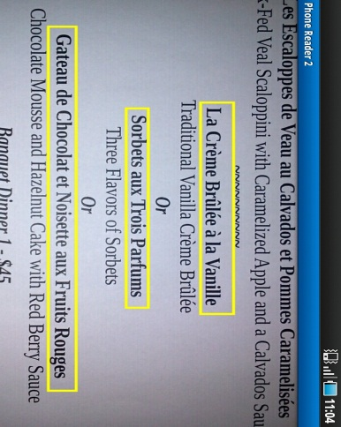
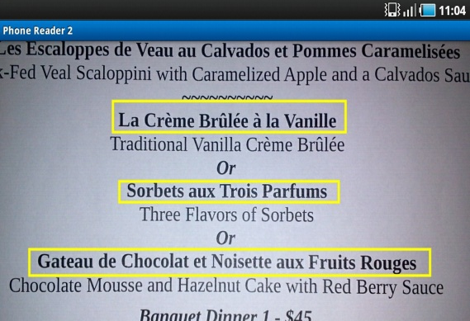
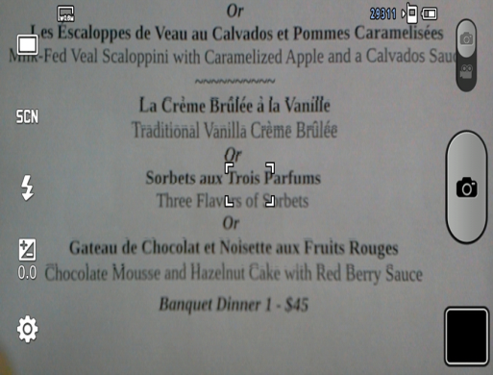
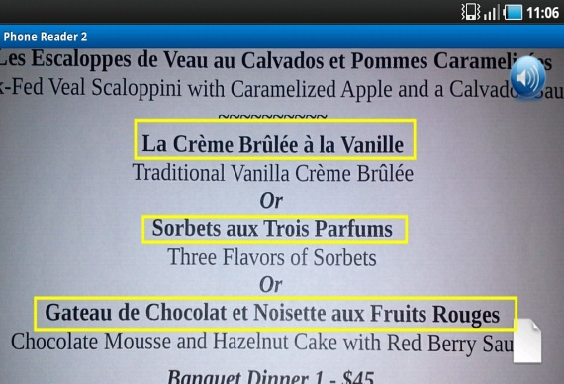
Implementation
Take picture
Make selections
Image Segmentation
Segment 1
Segment 2
Image up-sampling
Perform action
Segment 3
Image Thresholding

Slide 6
Testing
Performance Testing
Accuracy Testing
Usability Testing

Slide 7
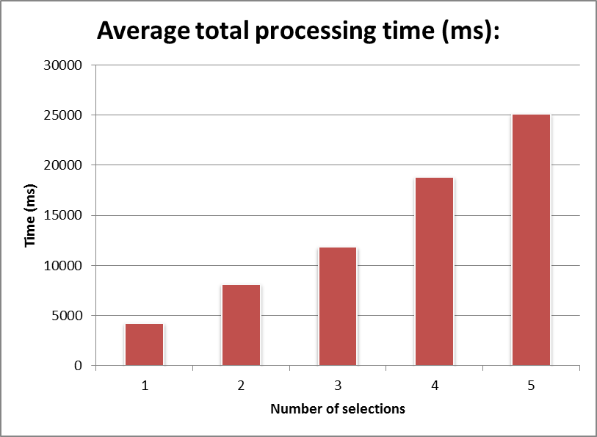
Performance Testing
Server-side processing
130 application executions

Slide 8
Performance Testing (cont.)
List of optimizations
Image Pre-processing
Previously, break into regions, threshold, up-sample.
Now, threshold, up-sample, break into regions.
Translation
Previously, translate every selection seperetely
Now, concatenate all the selections’ text together and translate simultaneously.

Slide 9
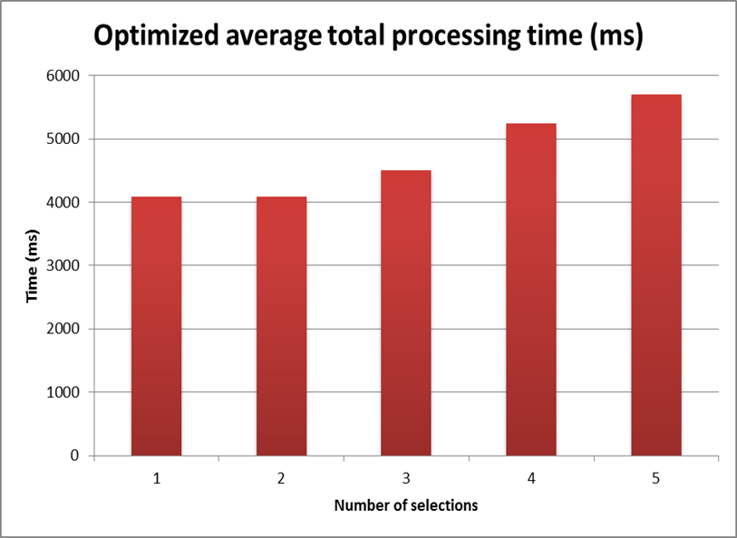
Performance Testing (cont.)
Optimized Server-side processing

Slide 10
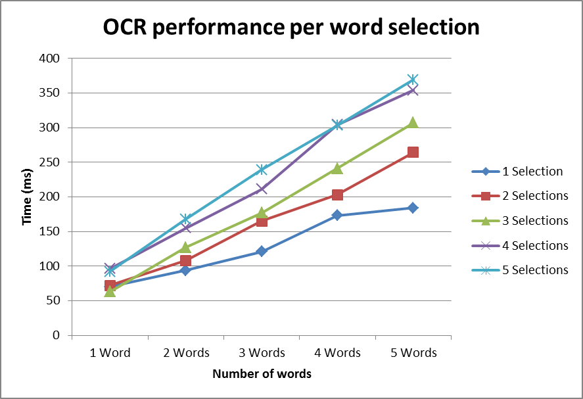
Performance Testing (cont.)
OCR performance based on text length
25 application executions

Slide 11
Accuracy Testing
Automatic Language Detection
130 application executions
Automatic Language Detection (No translation accuracy considered)
Language | Accuracy
Bulgrian | 96.20%
Catalan | 96.61%
Czech | 92.54%
Dutch | 75.50%
English | 100.00%
Finnish | 94.34%
French | 96.07%
German | 98.86%
Greek | 53.99%
Hungarian | 80.00%
Indonesian | 100.00%
Italian | 96.72%
Latvian | 73.71%
Lithuanian | 59.14%
Norwegian | 98.97%
Polish | 94.55%
Portuguese | 98.73%
Romanian | 97.00%
Russian | 98.33%
Slovak | 95.28%
Slovenian | 74.98%
Spanish | 93.51%
Swedish | 95.62%
Turkish | 94.89%
Ukranian | 97.57%
Vietnamese | 68.14%
Average overall accuracy | 89.28%

Slide 12
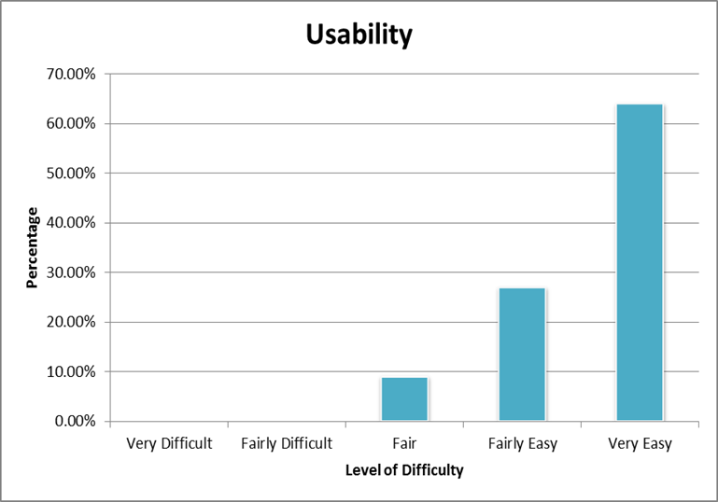
Usability Testing
11 Individuals

Slide 13
References
Bradsky, G., & Kaehler, A. (2008). Learning OpenCV Computer Vision with the OpenCV Library. California: O'Reilly Media Inc.
Morris, J. (2011). Android User Interface Development. Birmingham: Packt Publishing Ltd.
Felker, D., & Dobbs, J. (2011). Android Application Development FOR DUMMIES. New Jersey: Wiley Publishing Inc.

Slide 14
Demo
Overview:
Taking a picture
Making Selections
OCR using Automatic Language Detection and Translate
Play audio and display text

Slide 15
Questions and answers

